Slide 1
Employee Management System
SPRING BOOT + JPA + H2 + REACT IMPLEMENTATION
RAKSHA PAHARIYA

Slide 2
AGENDA
Project Overview
Learning Objectives
JPA & H2 Database
CRUD Operations
REST vs SOAP APIs
Results & Demo Output

Slide 3
PROJECT OVERVIEW
Purpose:
Build a working project to explore Spring ecosystem.
Learning Goals:
Understand Spring Boot project structure.
Practice REST API development.
Apply JPA for database mapping.
Use H2 DB for testing CRUD features.
React UI integration with backend APIs.
Scope:
Small HR-style application managing employee data.

Slide 4
JPA & H2 DATABASE
JPA (Java Persistence API):
H2 Database:
Maps Java classes → DB tables.
Eliminates raw SQL queries.
Works with Hibernate under the hood.
In-memory DB, resets each run.
Auto-configured with Spring Boot.
Ideal for learning & testing without external setup.
Key Relationship Between Them
JPA defines how to interact with data (objects → tables).
H2 acts as the storage engine where the data is actually stored.
Together, they allow rapid development and testing without complex setup.

Slide 5
CRUD OPERATIONS
Create (POST):
Add new employee.
Read (GET):
Fetch all employees or one by ID.
Update (PUT):
Modify existing employee details.
Delete (DELETE):
Remove an employee record.
Implementation:
Controller: Handles REST endpoints.
Service: Business logic.
Repository: DB operations via JPA.

Slide 6
REST VS SOAP API
REST (Implemented):
Simple, lightweight, JSON-based.
Follows HTTP verbs (GET, POST, PUT, DELETE).
Easy to integrate & modern standard.
SOAP (For comparison):
XML-based, uses WSDL.
Heavier but more secure.
Suitable for enterprise contracts

Slide 7
DEMO

Slide 8
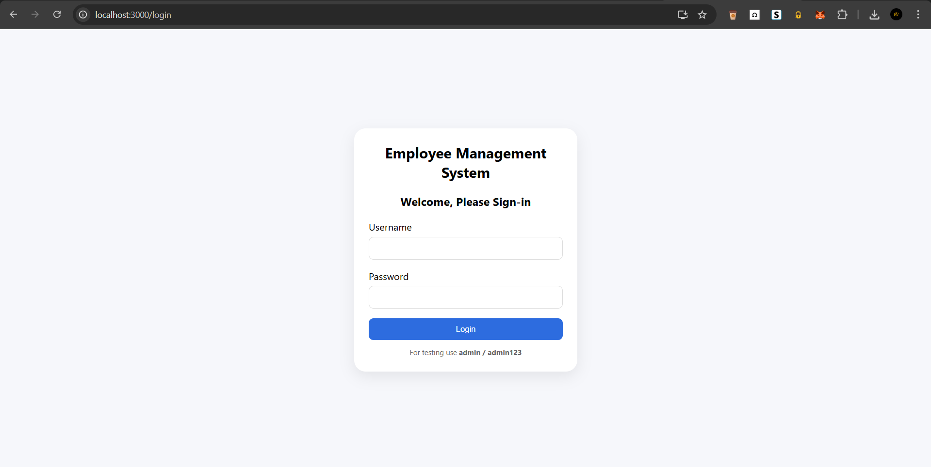
LOGIN SCREEN

Slide 9
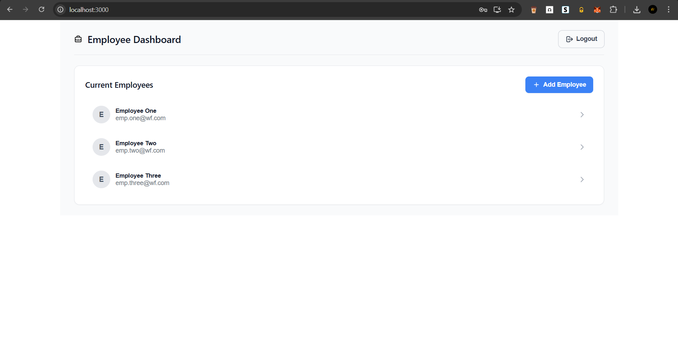
DASHBOARD

Slide 10
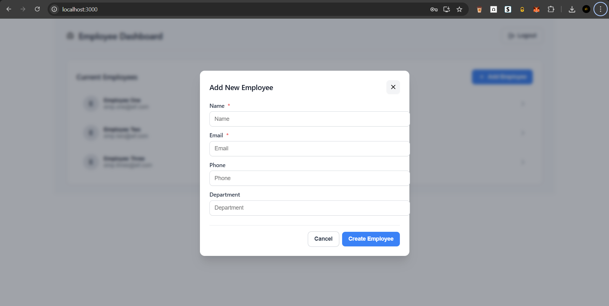
ADD EMPLOYEE

Slide 11
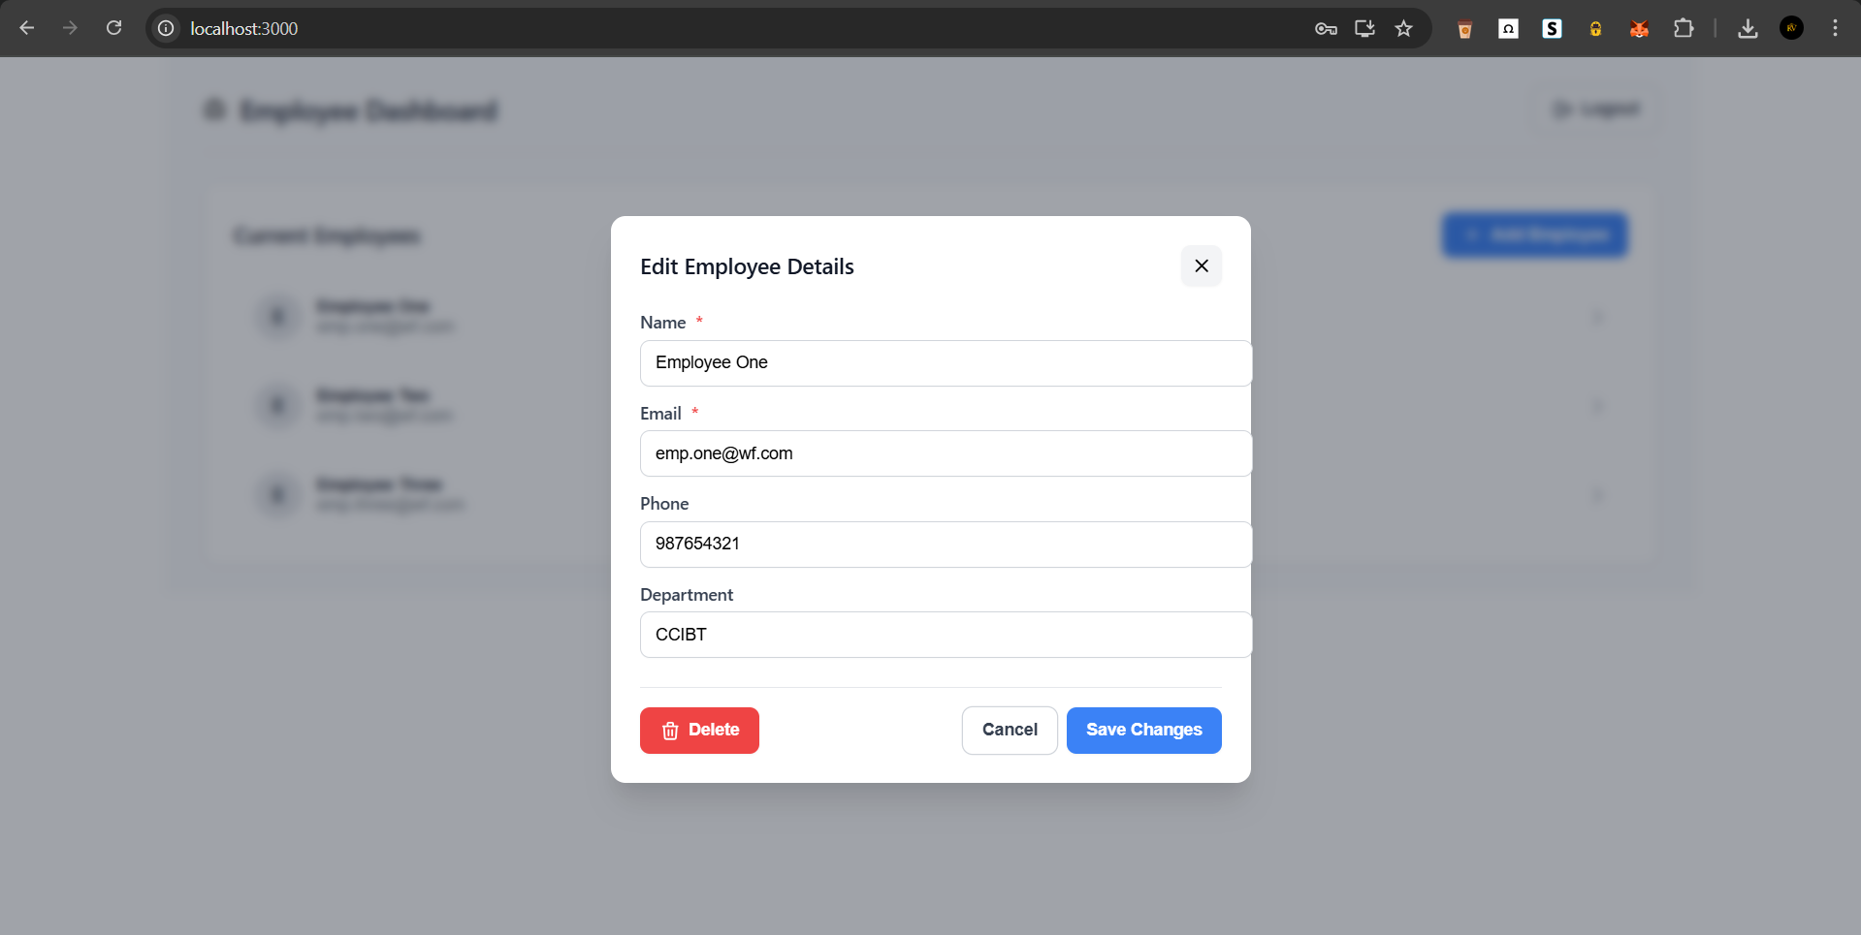
UPDATE/DELETE EMPLOYEE

Slide 13
RESULTS & CONCLUSION
Results:
Full-stack CRUD app with React frontend & Spring backend.
Tested via React UI + Postman + H2 Console.
Learnt how to connect frontend ↔ backend ↔ database.
Key Takeaways:
Gained practical knowledge of Spring Boot, REST, JPA, H2, and React.
Built layered architecture with real UI integration.

Slide 14
Thank you!
RAKSHA PAHARIYA

